Slide 1
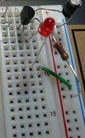
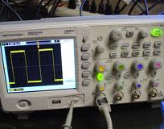
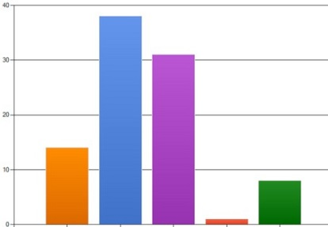
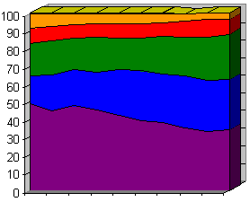

Experiment Refinement & Documenting Results
Ch1
Ch2
Ch3
Ch4
Ch5
Ch6
Welcome
Lit. Review
Methodology
Design
Results
Introduction & Conclusions
5th part of the guided research track (GRT)
RRSG Seminar
Prepared by Dr. Simon Winberg
Notes:
This presentation was prepared for the ‘guided research track’ (GRT) for new grad students

Slide 2
Today’s Meeting plan
The marking schema – planning the write-up
Short presentation (around 20mins):
Refining your experiment plans
Considerations for writing the Results Chapter(s).
Snippets of results imagery from past years (mostly copied from past orals presentations)
View of results chapters from past years
Discussion of design issues
Q&A
See last slide for references. These may also be useful to help you prepare and write your results chapter.

Slide 3

Where you should be in your project
You should already be past stage of system level / high level design
You should be well into the implementation and ideally already generating some results
You should be…
well into the implementation phase and hopefully have done some initial testing at this stage.

Slide 4
Ethics Clearance
Need to complete the Ethics form online
Please follow the online Ethics submission
https://universityofcapetown.submittable.com/submit

Slide 5
Thoughts about Getting High Marks
GRT

Slide 6
DEPARTMENT OF ELECTRICAL ENGINEERING FINAL YEAR PROJECT REPORT MARKING SCHEDULE - August 16
Student name: |  |  | Student No:
Report Title:
Mark allocation should be moderated by the difficulty of the project set.
 | Weight (%) | Comment Examiner writes brief comments here; adequate to justify mark. Use separate page if needed. |  | Assign a % mark out of 100% in each of the five boxes
Problem statement & literature review: Understanding the nature of the investigation | 20
Acquaintance with relevant literature
Design and Theory | 20
Practical work, simulation and software | 30
Results: Interpretation and conclusions | 20
Presentation, layout, referencing | 10
TOTAL | 100 | Report Mark (%)
CH1
CH2
CH2 & refs elsewhere
CH3&4 Methodology
& Design
CH5&6 Results &
Conclusion
All
Consistency in quality

Slide 7

Playing the rubric…
Or more accurately, getting your report to align perfectly with the marking rubric

Slide 8
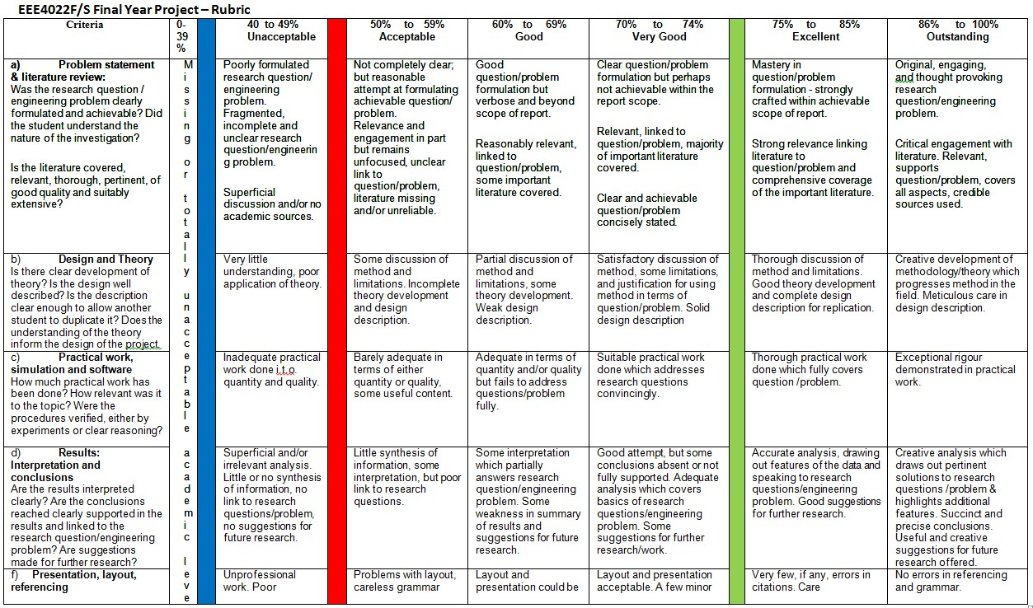
The marking rubric
Let’s zoom in on the top categories

Slide 9
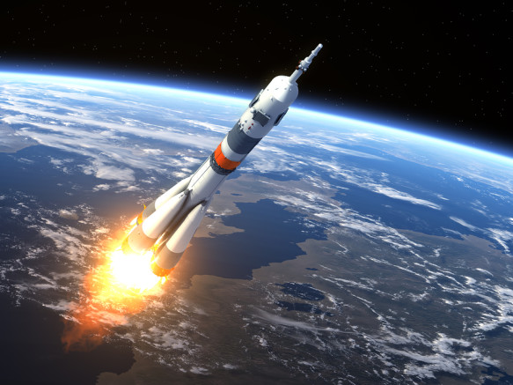
What will boost your EEE4022 into the stratosphere & beyond?
EEE4022S MARK

Slide 10
Excellent / Outstanding Problem Statement
Mastery in question/problem formulation - strongly crafted within achievable scope of report.
Original, engaging, and thought provoking research question/engineering problem.
Main thing is to express clearly the problem statement and research questions, a table of requirements and tests helps with this

Slide 11
Excellent / Outstanding Literature Review
Critical engagement with literature.
Means the objective analysis and evaluation of an issue in order to form a judgement.
Relevant, supports question/problem
Clearly connects to objective/questions/problem posed in the introduction
Covers all aspects
Provides a comprehensive response
Credible sources used
Good textbooks, peer reviewed articles from reputable journal/conference

Slide 12
Excellent / Outstanding Design and Theory
Thorough discussion of method & limitations.
But not a laborious discussion!
Good theory development and complete design description for replication
Use some diagrams too in the lit review!!
Meticulous care in design description.
For truly exceptional:
Creative development of methodology/theory which progresses method in the field

Slide 13
Excellent / Outstanding Practical Work
Fully covers question / problem.
For max marks:
Exceptional rigour
But managing a balance also, in that your ‘thorough but concise’, i.e. not just dumping all the possible design data and decisions, but rather suitably selecting relevant aspects and sufficiently important (e.g. for another student to repeat the project) details to document
Excellent figures, photos, screenshots goes without saying – these are very important

Slide 14
Excellent / Outstanding Results, Interpretation, Conclusions
Accurate analysis drawing out features of the data and speaking to research questions/problem.
Good and effective use of graphs/illustrations
Highlights additional features observed in experiments.
Clear and thorough explanations.
Refer to your figures, don’t just assume the reader will interpret your visuals
Good suggestions for further research.

Slide 15
Excellent / Outstanding Presentation, Layout, Referencing
Care taken in the writing
Well constructed sentences!!
Leave no figure unmentioned!!
No spelling and grammar mistakes
Consistent referencing style
Use a reference manager like Mendeley!

Slide 16

Get all that sorted & you’re beyond the stratosphere in terms of EEE4022 marks

Slide 17
Let’s think about the
RESULTS
chapter

Slide 18
Results Chapter
Your results should be clearly aligned to the methodology (CH3) where you describe how you are going to test the system and obtain results from the testing.
It should be logically structured, following an effective sequence, e.g.
Initial tests (possibly even phase 0, pre-study results)
Progressively more comprehensive testing

Slide 19
Results Chapter
Unsure of what to show?...
Err on the side of more rather than less results
How so?
Don’t just give the final testing results, unless it is indeed quite a complex system you are building.
Can provide evidence of having follow a research-based or experimental research design in which you test and validate decisions before moving on.
Be generous with the visuals
Remember to describe the figures… do not just throw in lot of figures and not explain and discuss them.
Strive towards a Suitably ‘balanced selection of figures and text’ …

Slide 20



Too many figures/data
But too many figures may lead to =>
Results camouflage = the important results are lost in the crowd
Confustication = confound + confuse
Marks:
100%
Lead to poor marks
0%
Confustication level
Principle: Consider each figure worth +/- 1000 words: too much data = information overload.

Slide 21
Important
Don’t leave documenting (or at least recording) & describing results to the end!!

Slide 22

Why shouldn’t you leave documenting results to the last few days?
Here are some reasons…
The descriptions might end up being of an inadequate quality,
i.e. vague / messy or look too much like being done in a rush.
Potential misalignment between objectives -> method -> result
(i.e. saying one thing and doing another)
Might not have time to show sufficient results, making the
examiner think you didn’t do enough practical work.
(Highly problematic common problem):
Forgetting what you did, or loosing results, and having to redo the experiments (likely done less carefully in the last minute)
Recall the project is likely follows the usual spiral model…

Slide 23




Results within the interactive and iterative Design Process
WHAT
WHY
…
Conceptual considerations
Characteristics
Functionality
Motivation for decisions made
Reasoning behind the design
Guiding principals
Literature
NEXT ISSUE
HOW
Technical design aspects
How system works / looks / fits together
4 3 6 3 7 9
RESULTS
x x x x x x x

Slide 24

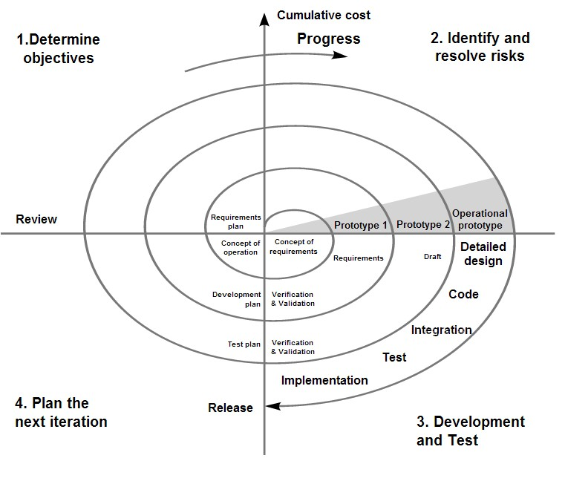
The spiral model of project development
Remember: Spiral model
Developer
etc…

Slide 25
Your Results Chapter
Structure of the results chapter is elaborated in the report template
Overview
How the results are structured, brief summary of what was done, refer back to the methodology.
Subsystem or module tests (possibly prior version tests if it can only be tested as a full system)
Functional testing; Module testing; Regression testing
Integration testing
System testing
Acceptance testing
User testing (+ e.g. Surveys)
[Maintenance testing]* advanced (shows how easy / maintainable the system is)

Slide 26
Alternate Result Chapter(s) Structure
To a certain extent, what your project involves influences how your results are shown. e.g…
In some cases it may be better to document ‘subsystem design – experiment - test’ chunks, followed by an integration / full system test i.e.
Chapter 1: Intro
Chapter 2: Literature review
Chapter 3: Methodology
Chapter 4: Subsystem 1
4.1 Design of subsystem 1
4.2 Testing / Results of subsystem 1
Chapter 5: Subsystem 2
…
Chapter N: Integration / System Testing
Chapter N+1: Conclusion

Slide 27

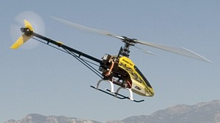
Recall: types of testing
Two broad types of testing:
Functional testing = testing just the functionality of the application
System testing = end to end / full product testing, i.e. testing of the whole system ideally in the context that it is meant to be used in.
Functional testing
System testing
Typically quicker to do, lab-based
Typically more involved, onsite

Slide 28
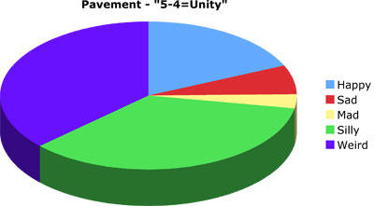
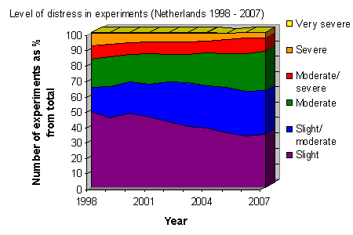
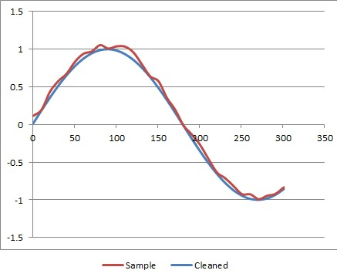
Visuals
It’s nice to have good use of visuals and tables in the results.
You don’t have to limit yourself to basic line or scatter graphs! Sometimes other graphs or visuals can show the results more effectively.
Fictional study of reading preferences
Pie chart
Stacked area graph
Line graph

Slide 29
Quantitative & Qualitative Results
Engineers generally expect mostly quantitative result reporting
But there should be some of both
But again, it depends on the nature of the project concerned.
Usually:
More People involved -> more qualitative results expected
Less people involved -> more quantitative results expected
Remembering that:
Qualitative = measurement of quality rather than its quantity.
Quantitative = measurement of quantity rather than its quality.

Slide 30

NB: Your Results should correspond To Your Objectives!
Try to show good consistency and integration between the chapters of your write-up
Remind the user or emphasize how particular results link back to the requirements & main objectives
Make use of cross-references to help show the connectedness:
Keep your eye on the ball objectives
connect: objectives → requirements → specifications → design → testing & results → conclusions → future work

Slide 31

Demonstration & discussion: Results shown in past BSc Orals

Slide 32
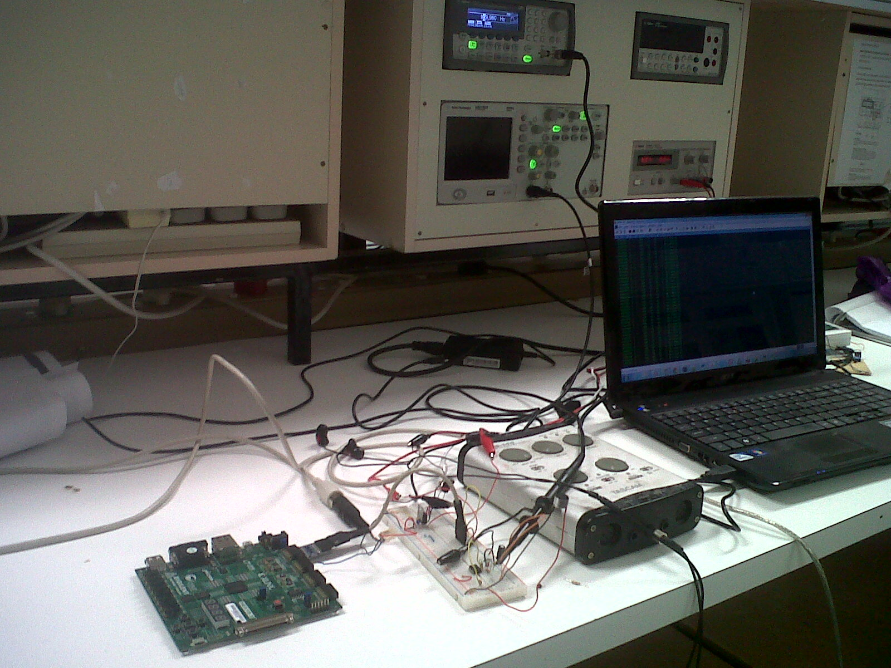
A setup snapshot
Thabiso Nthathakane -- whistle to Midi convertor system

Slide 33
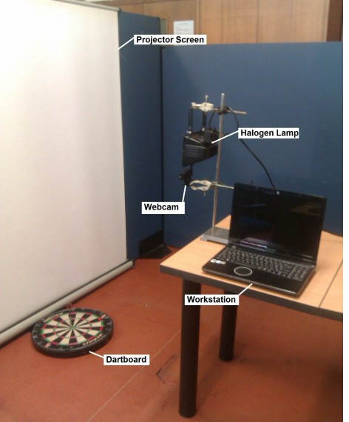
Experimental setup
Falling Dart Scenario
Components:
Workstation
Webcam
Halogen lamp
Projector screen
Dartboard
“Vision Based Dart Speed Meter” - Matthew Koen

Slide 34
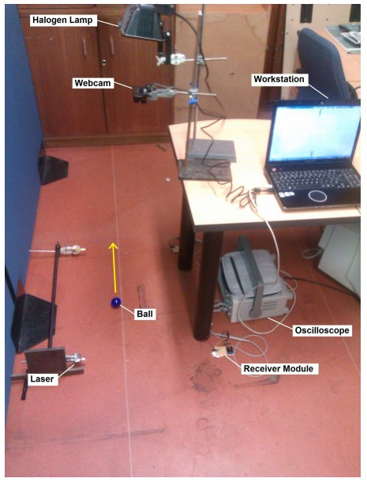
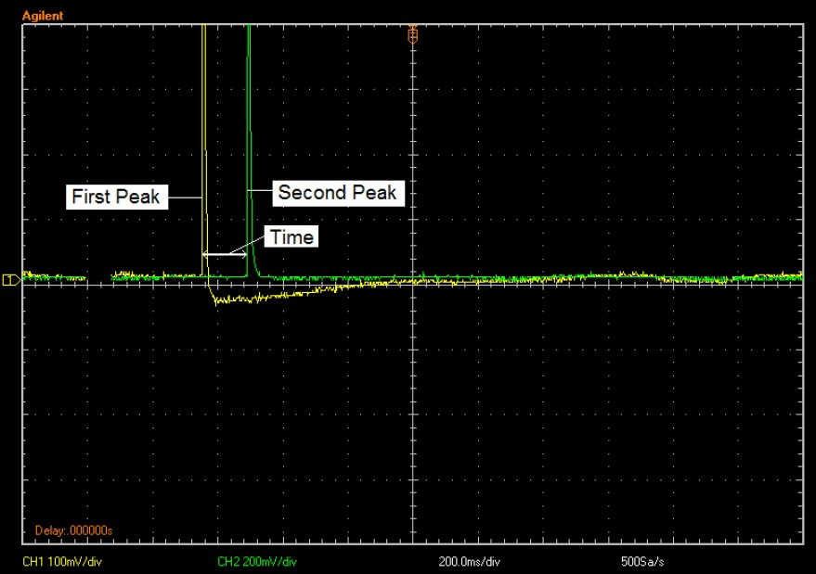
Experimental results
Rolling Ball Scenario
Snapshot of oscilloscope showing time values
The data capturing process was as follows:
1. Firstly, the camera was calibrated
2. User clicked a button to initiate acquisition of images
Ball rolled at moderately high speed along the white line
4. The ball crossed the first and then second laser, creating two spikes in the waveform
5. After 3 seconds, image acquisition was terminated
6. Finally, a snapshot of the oscilloscope’s display was uploaded to the workstation.
“Vision Based Dart Speed Meter” - Matthew Koen

Slide 35



Review of existing products
Functionality/Feature | P1 | P2 | P3
MASTER STATION
Billing System | ☺ Yes | ☺ Yes | ☺ Yes
Vending System | ☹ No | ☺ Yes | ☺ Yes
Data Warehouse | ☺ Yes | ☺ Yes | ☺ Yes
Load Management | ☹ No | ☺ Yes | ☺ Yes
Tamper Detection | ☹ No | ☺ Yes | ☺ Yes
Fault Investigation | ☹ No | ☺ Yes | ☺ Yes
Quality of Supply | ☹ No | ☹ No | ☺ Yes
AMI METER
CIU | ☹ No | ☺ Yes | ☺ Yes
ACD | ☹ No | ☺ Yes | ☺ Yes
Load Switch | ☹ No | ☺ Yes | ☺ Yes
COMMUNICATION
GSM/GPRS | ☺ Yes | ☺ Yes | ☺ Yes
PLC | ☹ No | ☹ No | ☹ No
ZigBee | ☹ No | ☺ Yes | ☺ Yes
TCP/IP | ☺ Yes | ☺ Yes | ☺ Yes
PSTN/IDSN | ☺ Yes | ☹ No | ☹ No
“What
vendors
made”
Investigation of a Smart Communication Networks Standards for Smart Energy Management with Smartgrids
Author: Monontši Paul Nthontho

Slide 36
Validating Simulation
Aim: To determine utilization of the communication network.
Methods and Materials: OPNET 14.0 used to model the AMI network for The City of Cape Town.
OPNET snapshot of Modelled network:
The subnet represents a
detailed network of AMI
meters for a city.
Legend:
Subnet
Author: Monontši Paul Nthontho

Slide 37
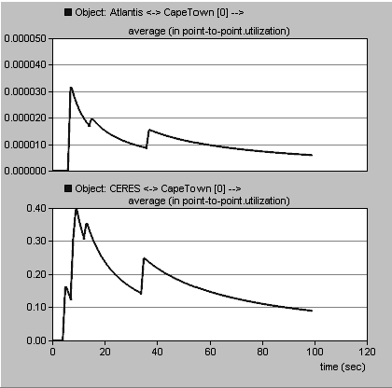
Validating Simulation Results
Graphs 1 and 2 show maximum utilization of network capacity
between Cape Town control centre and Atlantis and Ceres respectively
1
Graph 1:
Link Type: Optic Fibre
Link bandwidth: 100Mbps
Utilization: 0.032%
2
Graph 2:
Link Type: DS0
Link bandwidth: 64kbps
Utilization: 4%
Author: Monontši Paul Nthontho

Slide 38
Demonstration & discussion: Results Chapters from past BSc reports

Slide 39

Now over to you

Slide 40
Discussion
&
Questions

Slide 41

Ch1
Ch2
Ch3
Ch4
Ch5
Ch6
Welcome
Lit. Review
Methodology
Design
Results
Introduction & Conclusions
Planning ahead:
No meeting planned for next week
No meetings for a few weeks until…
(meeting to be announced): last meeting 1 week before due date; GRT Presentation on: Conclusions and getting the Introduction to link nicely to the conclusions and rest of the report

Slide 42
Refs
Some recommended reading…
How to write a dissertation: a free online short course (useful content you can view without doing the course)
Course start page: http://www.mondofacto.com/study-skills/research/how-to-write-your-dissertation/
Writing up Results: http://www.mondofacto.com/study-skills/research/how-to-write-your-dissertation/04.html
UCT Library books
Scientific style and formatting 808.0666 SCIE
Writing academic papers & books 808.02 HAYN

